Slide 1
Problem solving with place value
Place value

Slide 2
how to use Oak lessons

Slide 3
I can use my knowledge of place value to solve problems.

Slide 4
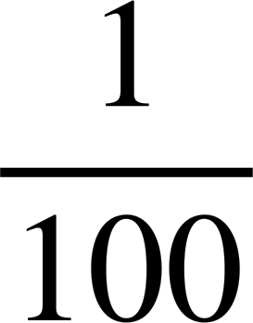
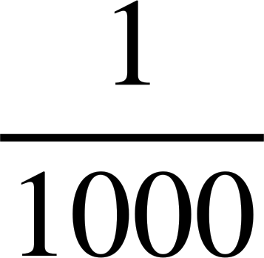
Metric units are based around the standard units of metre, gram and litre.
A prefix is a group of letters attached to the front of a root (word) to make a new word, for example tricycle.
Centi placed before a unit means
Milli placed before a unit means
Kilo placed before a unit means 1000 times.

Slide 5

Problem solving with place value
Same measure, different units
Determining useful units of measure

Slide 6
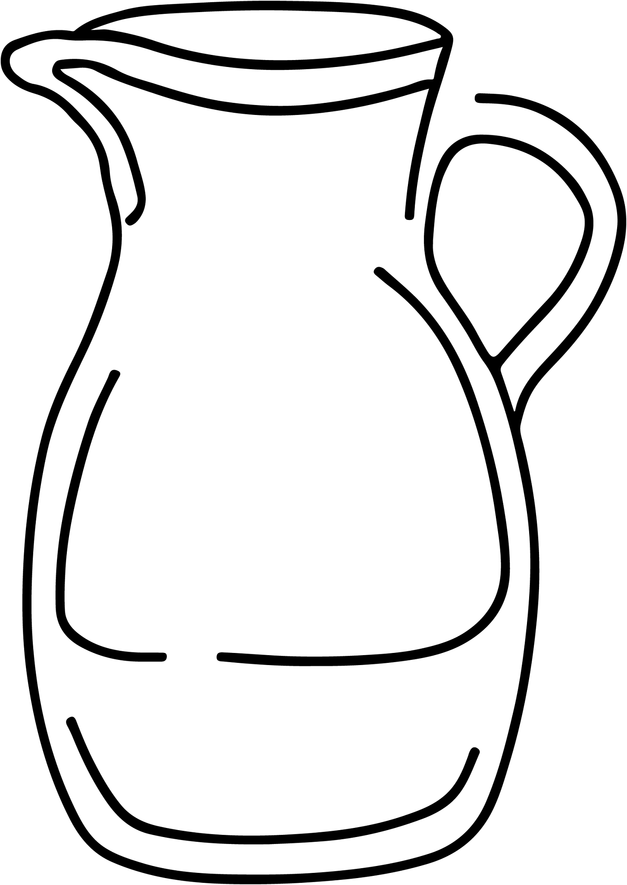
Same measure, different units
Measures are not always written with the same units.
330 millilitres
0.33 litres
Do these two containers hold the same amount of liquid?
Justify your answer.

Slide 7
Same measure, different units
330 millilitres
0.33 litres
1 litre is equivalent to 1000 millilitres.
0.33 litres × 1000 = 330 millilitres
The two containers hold the same amount of liquid.

Slide 8
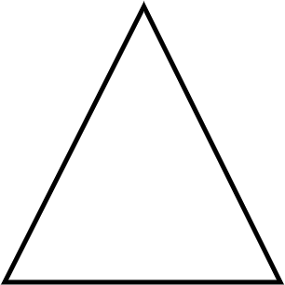
Same measure, different units
An isosceles triangle has two sides which are the same length.
Pick three measurements to make an isosceles triangle.
4.6 m 406 cm 460 cm 4600 mm

Slide 9

Same measure, different units
Pick three measurements to make an isosceles triangle.
4.6 m
460 cm
4600 mm
4.6 m
406 cm
460 cm
4600 mm
× 100
× 10
4.6 m = 460 cm = 4600 mm
To make an isosceles triangle, we need two of these measurements.
The third measurement must be 406 cm since it is not the same length.

Slide 10
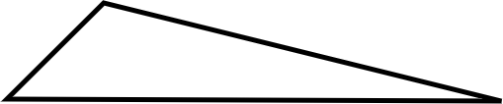

Same measure, different units
In a scalene triangle, all the side lengths are different. Which measurements could be the lengths of a scalene triangle?
16.9 cm, 10.9 cm, 0.169 m
230.75 m, 0.2375 km, 23 700.5 cm
292 cm, 1.87 m, 3000 mm

Slide 11
Same measure, different units
a) 16.9 cm, 10.9 cm, 0.169 m
E.g.
0.169 m can be converted to cm by multiplying by 100.
0.169 m × 100 = 16.9 cm
There are two sides with the same length. Therefore this is not a scalene triangle.

Slide 12
Same measure, different units
b) 230.75 m, 0.2375 km, 23 700.5 cm
E.g.
230.75 m can be converted to cm by multiplying by 100.
230.75 m × 100 = 23 075 cm
0.2375 km can be converted to m by multiplying by 1000 and then to cm by multiplying by 100.
0.2375 km × 1000 × 100 = 23 750 cm
There are no sides with the same length. Therefore this is a scalene triangle.

Slide 13
Same measure, different units
c) 292 cm, 1.87 m, 3000 mm
E.g
There is no need to convert any measurements as multiplication and division using multiples of 10 changes the place value of the digits, but does not change which digits are used.
Measures can be converted to the same units to make comparison easier, but this is not always necessary.

Slide 14
Same measure, different units
Here is an important reminder about two types of triangles.
An isosceles triangle has two sides which are the same length.
A scalene triangle has no sides with the same length.

Slide 15
Same measure, different units
For each set of measurements, deduce if they are the lengths of a scalene or an isosceles triangle.
1) 1.739 m, 173.9 cm, 1793 mm
2) 0.032 km, 3020 cm, 32 000 mm
3) 5.1 cm, 0.000053 km, 50.3 mm

Slide 16

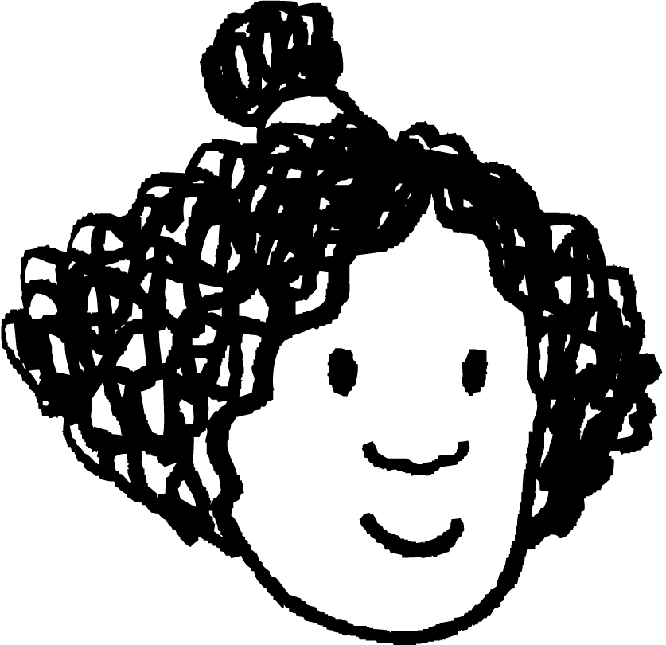
Same measure, different units
4) Izzy has measured the sides of a triangle.
Why might you think that Izzy has made an error?
How could you check?
I measured lengths of 31.2 cm, 24.9 cm and 9.3 mm

Slide 17
Same measure, different units
For each set of measurements, deduce if they are the lengths of a scalene or an isosceles triangle.
1) 1.739 m, 173.9 cm, 1793 mm
E.g.
Only the lengths 1.739 m and 173.9 cm have the same digits in the same order. These are the lengths I need to check.
1.739 m × 100 = 173.9 cm
These lengths are the same. This is a set of lengths for an isosceles triangle.

Slide 18
Same measure, different units
For each set of measurements, deduce if they are the lengths of a scalene or an isosceles triangle.
2) 0.032 km, 3020 cm, 32 000 mm
E.g
Only the lengths 0.032 km and 32 000 mm have the same digits in the same order. These are the lengths I need to check.
0.032 km × 1000 × 100 × 10 = 32 000 mm
These lengths are the same. This is a set of lengths for an isosceles triangle.

Slide 19
Same measure, different units
For each set of measurements, deduce if they are the lengths of a scalene or an isosceles triangle.
3) 5.1 cm, 0.000053 km, 50.3 mm
E.g.
None of the lengths have the same digits in the same order. None of the lengths will be the same when converted.
None of the lengths are the same. This is a set of lengths for a scalene triangle.

Slide 20
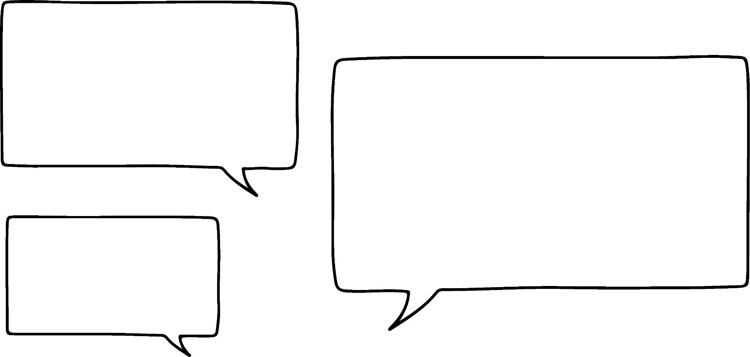
Same measure, different units
4) Izzy has measured the sides of a triangle.
I measured lengths of 31.2 cm, 24.9 cm and 9.3 mm
Why might you think that Izzy has made an error?
E.g.
Izzy has measured one length in mm. This might be ok but when converted to cm, it is 0.93 cm. This seems a lot smaller than the other measurements.

Slide 21
Same measure, different units
4) Izzy has measured the sides of a triangle.
I measured lengths of 31.2 cm, 24.9 cm and 9.3 mm
How could you check?
E.g.
I could remeasure that side to see if I get the same measurement again.
I could try to draw a triangle with Izzy’s measurements.

Slide 22
Problem solving with place value
Same measure, different units
Determining useful units of measure

Slide 23
Determining useful units of measure
When measuring something, the units you measure in determine the place value of each digit.
For example
An ant measures 3 mm in length.
An ant measures 0.3 cm in length.
An ant measures 0.003 m in length.
An ant measures 0.000003 km in length.
Which unit do you think is best to use in this case?

Slide 24
Determining useful units of measure
An ant measures 3 mm in length.
An ant measures 0.3 cm in length.
An ant measures 0.003 m in length.
An ant measures 0.000003 km in length.
It is sensible to use millimetres as this unit results in an integer value. The unit also gives us an idea of how big an ant is.

Slide 25
Determining useful units of measure
The distance between England and France should be measured in .
millimetres
The shortest distance between England (Dover) and France (Calais) is approximately 34 km.
This is also 34 000 m, 3 400 000 cm or 34 000 000 mm.
centimetres
metres
kilometres

Slide 26
Determining useful units of measure
The distance between England and France should be measured in .
inches
The shortest distance between England (Dover) and France (Calais) is approximately 21 miles.
This is also 36 960 yards, 110 880 feet or 1 330 560 inches.
feet
yards
miles

Slide 27
Determining useful units of measure
1) Fill in the gaps using an appropriate unit of measure from the box.
I recently visited Paris. It took 2 and 37 . to get there by train. I visited the Eiffel Tower, which is 330 tall. Whilst at the Eiffel Tower, I visited a souvenir shop and bought 0.5 of sweets to share with my friends.
grams kilograms millimetres centimetres metres kilometres seconds minutes hours millilitres

Slide 28
Determining useful units of measure
2) Which metric measures might be used to measure the following?
a) Length of an ant
b) Mass of a person
c) Capacity of a bucket
d) Height of a house

Slide 29
Determining useful units of measure
3) Which imperial measures might be used to measure the following?
a) Length of an ant
b) Mass of a person
c) Capacity of a bucket
d) Height of a house

Slide 30
Determining useful units of measure
1) Fill in the gaps using an appropriate unit of measure from the box.
I recently visited Paris. It took 2 hours and 37 minutes to get there by train. I visited the Eiffel Tower, which is 330 metres tall. Whilst at the Eiffel Tower, I visited a souvenir shop and bought 0.5 kilograms of sweets to share with my friends.

Slide 31
Determining useful units of measure
2) Which metric measures might be used to measure the following?
a) Length of an ant millimetres
b) Mass of a person kilograms
c) Capacity of a bucket litres
d) Height of a house metres

Slide 32
Determining useful units of measure
3) Which imperial measures might be used to measure the following?
a) Length of an ant inches
b) Mass of a person stones or pounds
c) Capacity of a bucket pints
d) Height of a house feet

Slide 33
Problem solving with place value
Measures can be converted to the same units to make comparison easier.
This is not always necessary as comparing the order of the digits can be enough.

Slide 34

© Oak National Academy 2023.
Produced in partnership with Mathematics in Education and Industry.
Licensed on the Open Government Licence v3.0, except where otherwise stated. See Oak terms and conditions.

